Slide 1
Yelp Database Creation and Data Exploration
Cal Davis, Paul Derisemu, Zain Hoda, Tejas Phirke

Slide 2
Agenda
Data Source Introduction
Database Ingestion into SQL
Exploratory Data Analysis
Understanding the Impact of One-Review Reviewers
Testing, Analysis, and Theories of Review Flaws in Yelp
Recommendations
Q & A

Slide 3
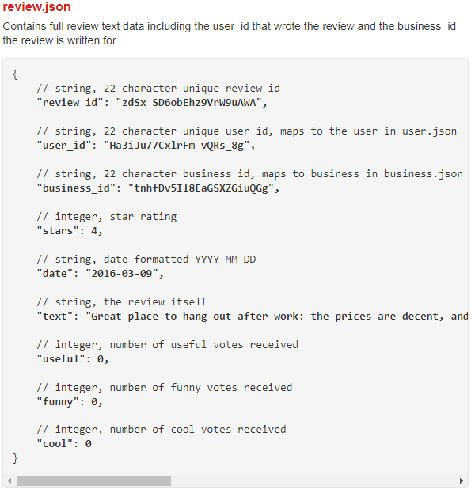
Original Format and Data Introduction
Yelp Dataset
  JSON files
Ingested Files
  Business
  Review
  User
  Checkin
  Tip

Slide 4
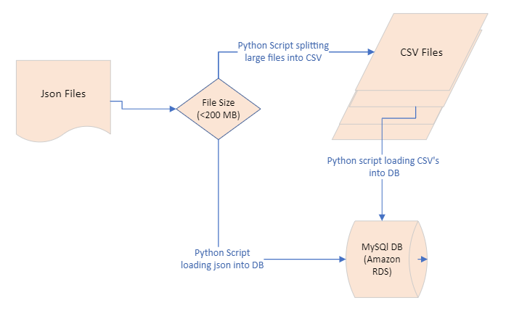
Data Ingestion

Slide 5
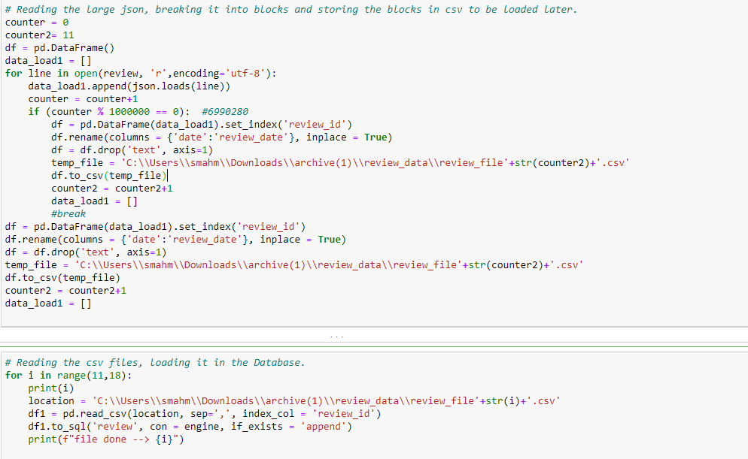
Data Ingestion Script

Slide 6
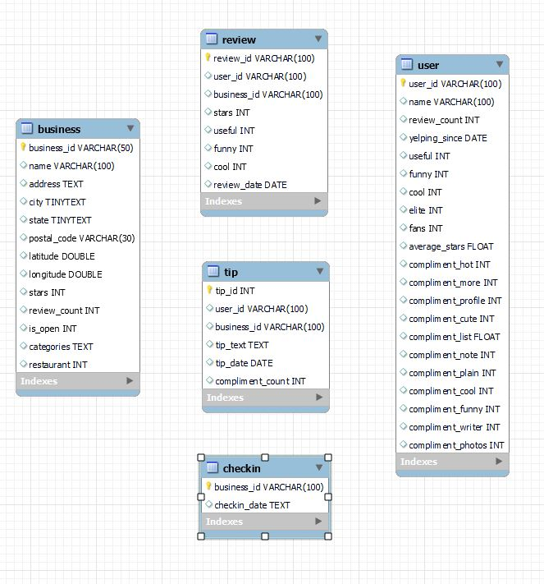
Database in MySQL
ER Diagram
Data Sanity Checks:
We decided to store our data in MySQL Database hosted remotely using Amazon RDS.
We did that because we wanted to keep our focus on the following:
Data Management
Developing understanding of Data
Analytics on Data

Slide 7
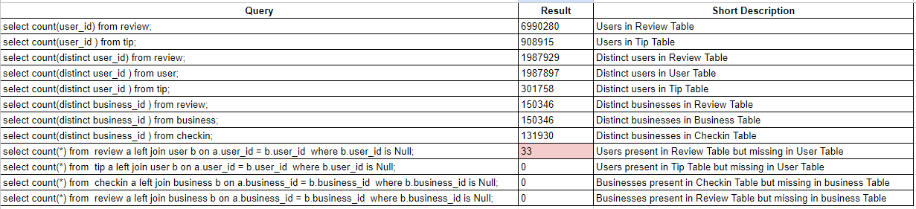
Basic Data Sanity Checks:
Notes:
We loaded the data in tables only with Primary Key constraints and not Foreign Key Constraints.
We wanted to make sure that we were not comparing apples to oranges so we want to ensure that there is no mismatch between the tables for example : Reviewers are missing in User Table or Reviews for non-existing businesses are present.

Slide 8
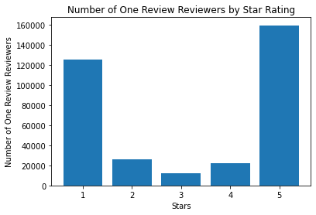

Initial Observation #1
Don’t we want to get a fair review?
Okay, but like its not that many with 1 review, right?

Slide 9
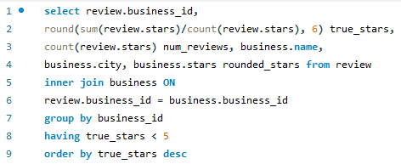
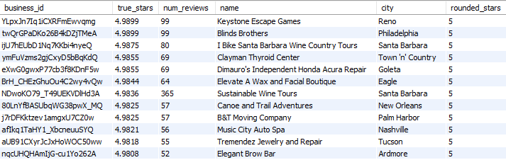
Initial Observation #2
Notes:
Users and business tables had ROUNDED stars, we wanted a “true star” rating for these restaurants
We see that there is little difference in the table on the right, but we wanted a more precise value when doing analysis

Slide 10
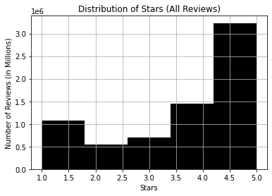
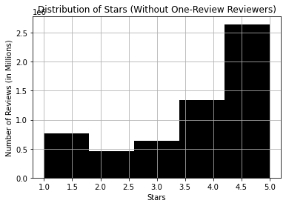
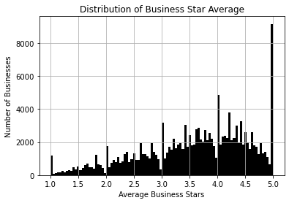
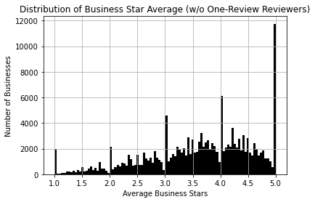
What happens if we remove these one-review reviewers?

Slide 11
What happens if we remove these one-review reviewers?
Current State:
  Overall Average Star Rating:
    3.7486
  Average Business Star Rating:
    3.5875
State after Removing One-Review Reviewers:
  Overall Average Star Rating:
    3.7944
  Average Business Star Rating:
    3.6278

Slide 12


Comparison of Two Nashville Restaurants
Tacos Aurora
3.7 “True Star Rating”
La San Marquena Restaurant
4.5 “True Star Rating”
Tacos Aurora
4.2 “True Star Rating”
La San Marquena Restaurant
3.7 “True Star Rating”
Which restaurant would you choose?
(Let’s remove those one-review reviewers)

Slide 13
An Investigation of Low Review Counts Affecting Business Stars
Yelp Dataset
Business:
<2 Stars
Business:
>4 Stars
Users:
<=4 Reviews
Users:
>4 Reviews
Users:
<=4 Reviews
Users:
>4 Reviews
Hypothesis Test for Difference in Mean Stars:
H₀: μ_{Stars w >3 Review-Reviewers}-μ_{Stars w <=3 Review-Reviewers}=0
H₁: μ_{Stars w >3 Review-Reviewers}-μ_{Stars w <=3 Review-Reviewers}≠0
Hypothesis Test for Difference in Mean Stars:
H₀: μ_{Stars w >3 Review-Reviewers}-μ_{Stars w <=3 Review-Reviewers}=0
H₁: μ_{Stars w >3 Review-Reviewers}-μ_{Stars w <=3 Review-Reviewers}≠0

Slide 14
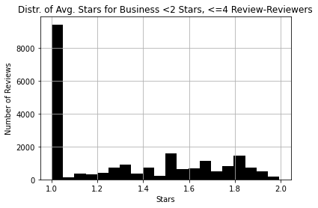
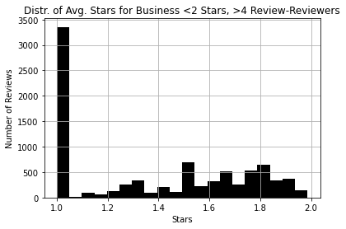
Businesses with Less Than 2 Stars Investigation
<=4 Reviewers
Avg. True Stars: 1.32
Std. Dev True Stars: 0.33
>4 Reviewers
Avg. True Stars: 1.38
Std. Dev True Stars: 0.35
t-statistic: -13.4
p-value: ~0.0
Notes:
A p-value <0.05 indicates that the hypothesis can be rejected and that there is a difference in means amongst the two groups here. This indicates that some reviews are likely giving an overreaction of bad reviews on restaurants.

Slide 15
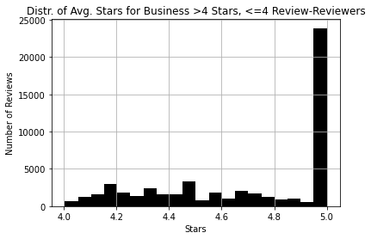
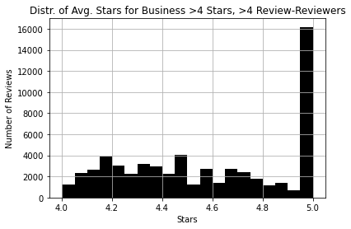
Businesses with More Than 4 Stars Investigation
<=4 Reviewers
Avg. True Stars: 4.69
Std. Dev True Stars: 0.33
>4 Reviewers
Avg. True Stars: 4.59
Std. Dev True Stars: 0.33
t-statistic: 56.1
p-value: ~0.0
Notes:
A p-value <0.05 indicates that the hypothesis can be rejected and that there is a difference in means amongst the two groups here. This indicates that some reviews may be a part of a scheme in which businesses are giving promotions/ discounts in exchange for high reviews.

Slide 16
Recommendations
Why do we care if mid-level restaurants are getting pulled down or up by these users with low reviews?
  Customer Decision Making (Nashville Mexican Restaurant example)
  Inaccurate Reflection in Business Quality
Yelp should show “true” star ratings
  Not rounded to the nearest whole/ half-star
Modified Scoring System Alternatives
  User review count threshold
  Weighted Star Rating
  Performance Tier System (Kaggle)

Slide 17
Q & A

